Slide 1
AI Security: Course Logistics
Sangdon Park
Assistant Professor
Machine Learning Lab
Graduate School of AI (GSAI)
Computer Science and Engineering (CSE)
POSTECH

Slide 2

TA
Sechan Lee (GSAI)

Slide 3
Textbook
No Official Textbook

Slide 4
Grading
Assignment / Presentation (80%)
HW1 (10%)
HW2 (20%)
Final Project (50%)
Participation (20%)
5% for each (question, answer) pair
Attendance
Not part of grading if you satisfy the university rule.
Use the auto check-in system.
Note
Grad students – recommend to audit.

Slide 5
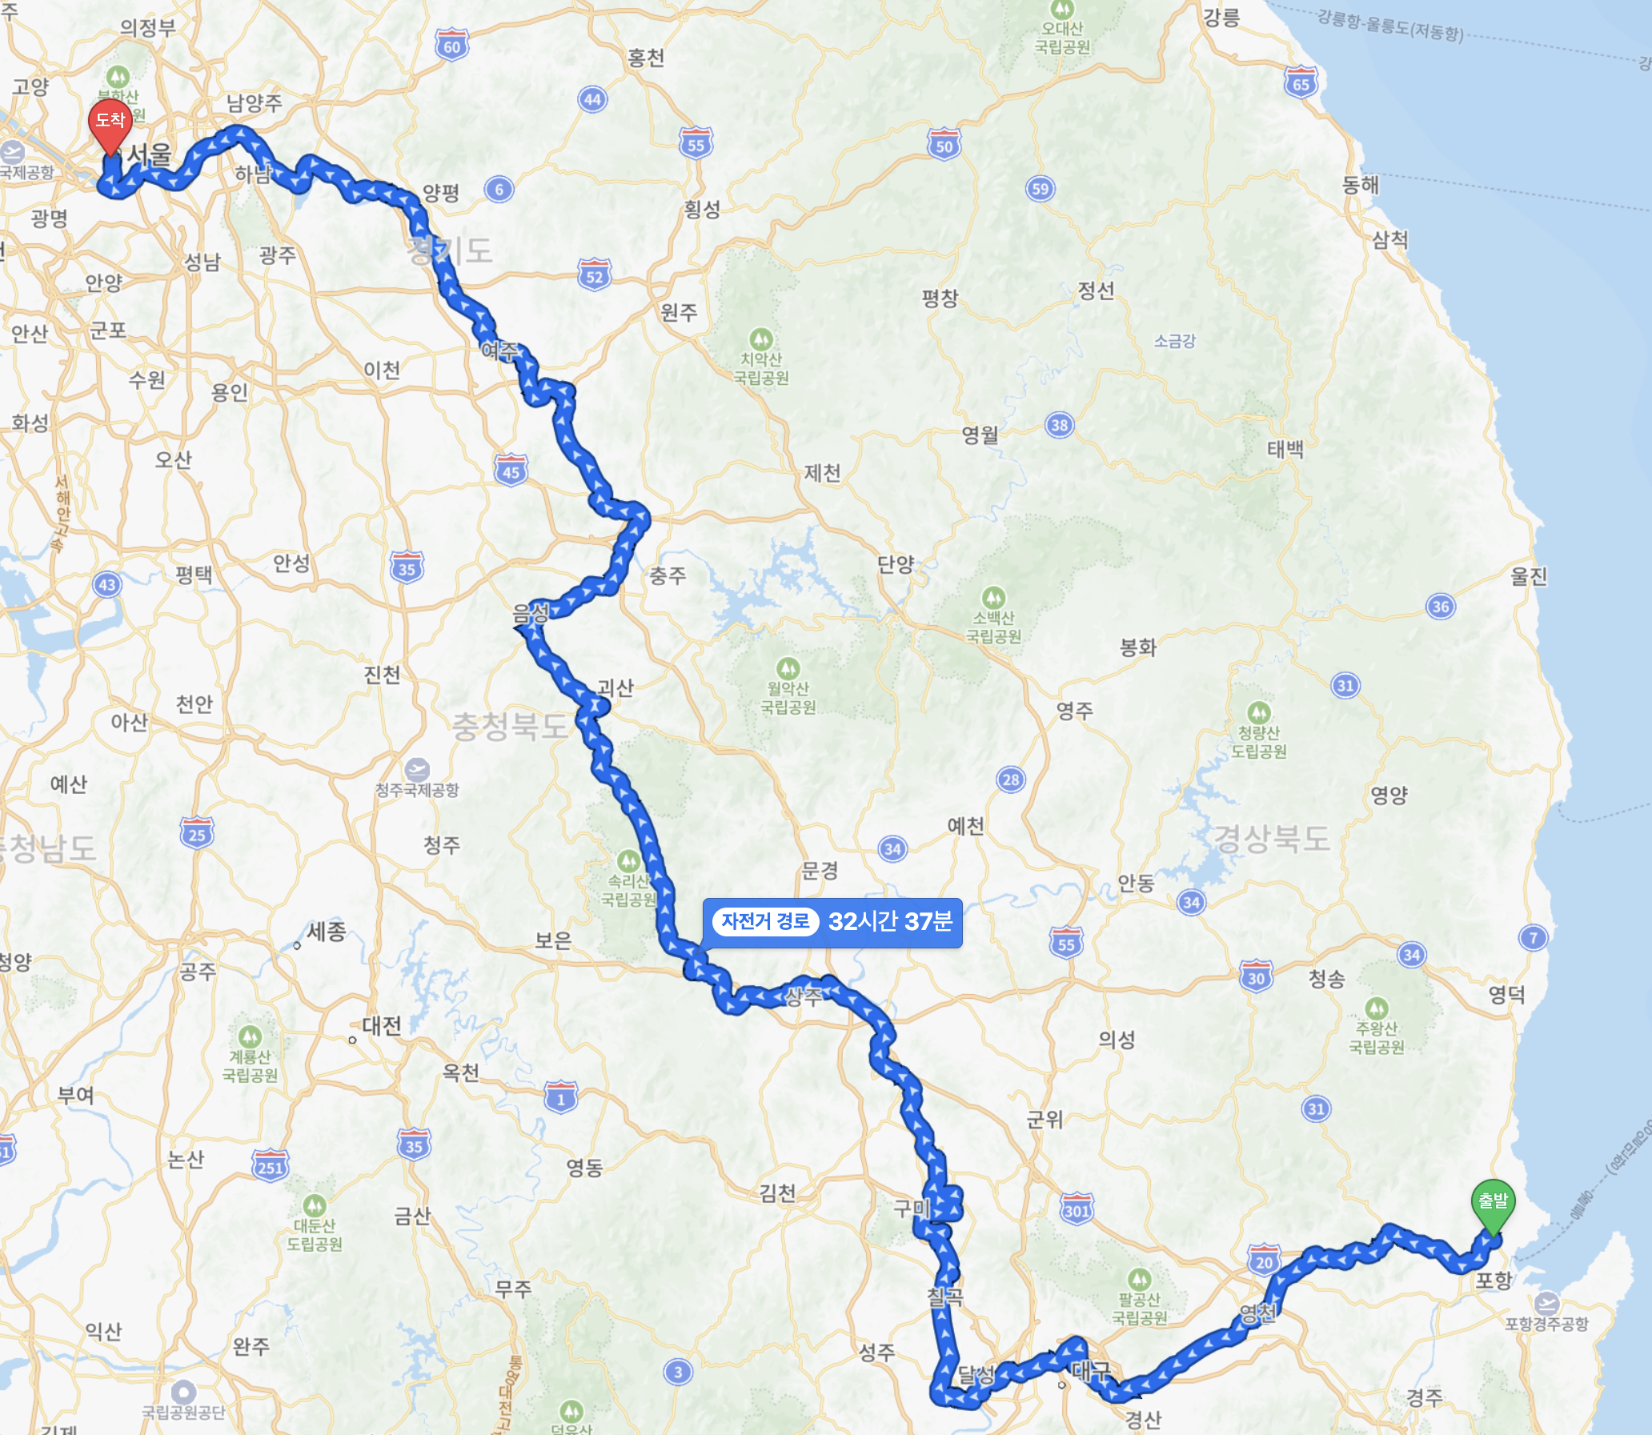
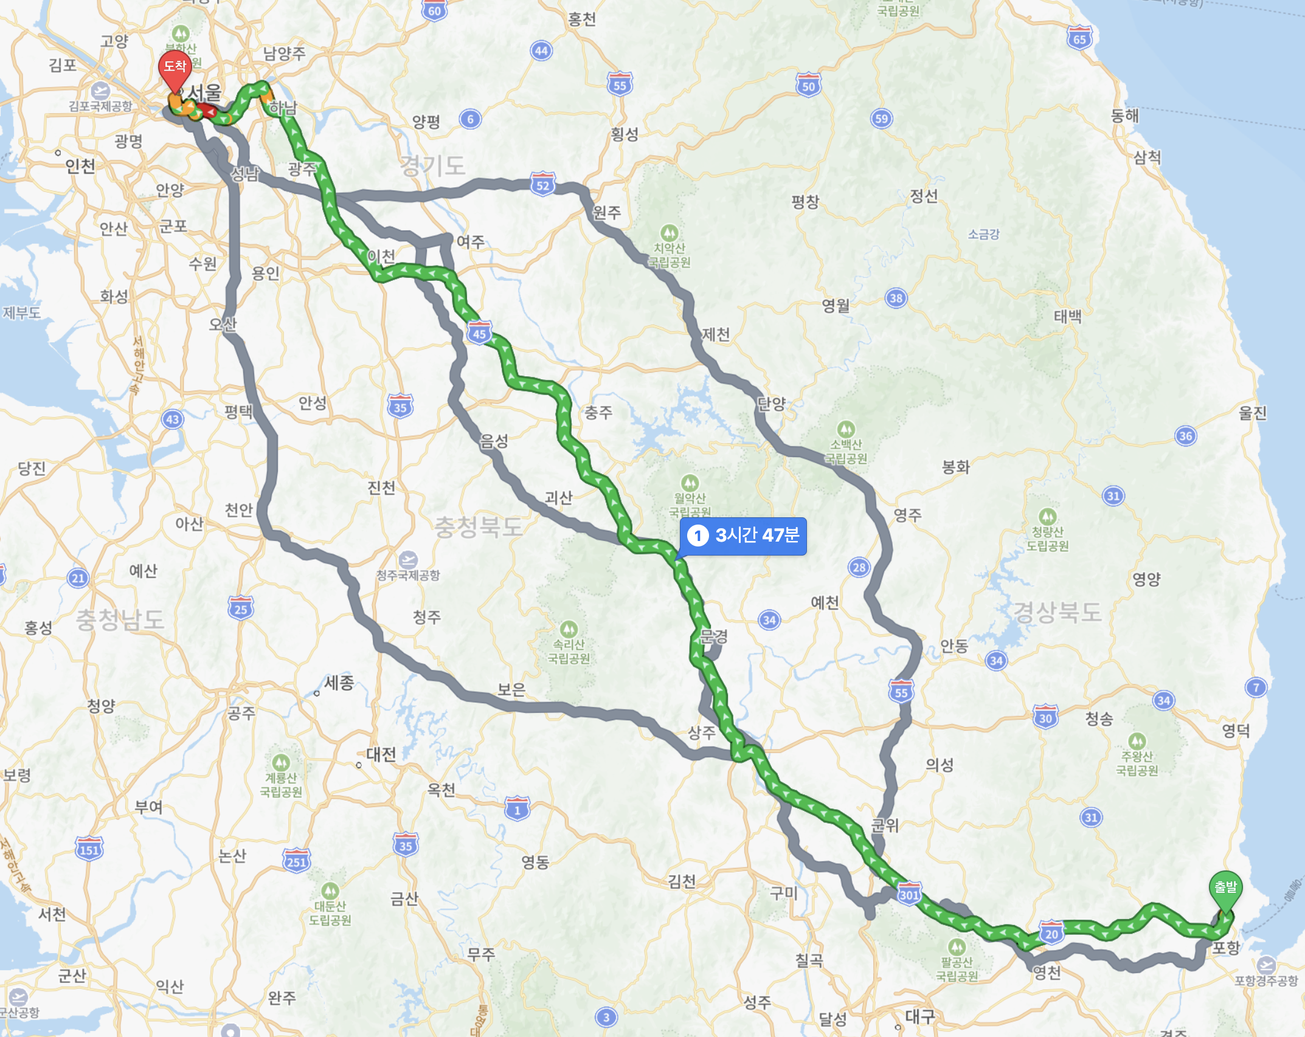
GenAI Usage Policy Should We Use Generative AI?
Should We Use A Car?

Slide 6
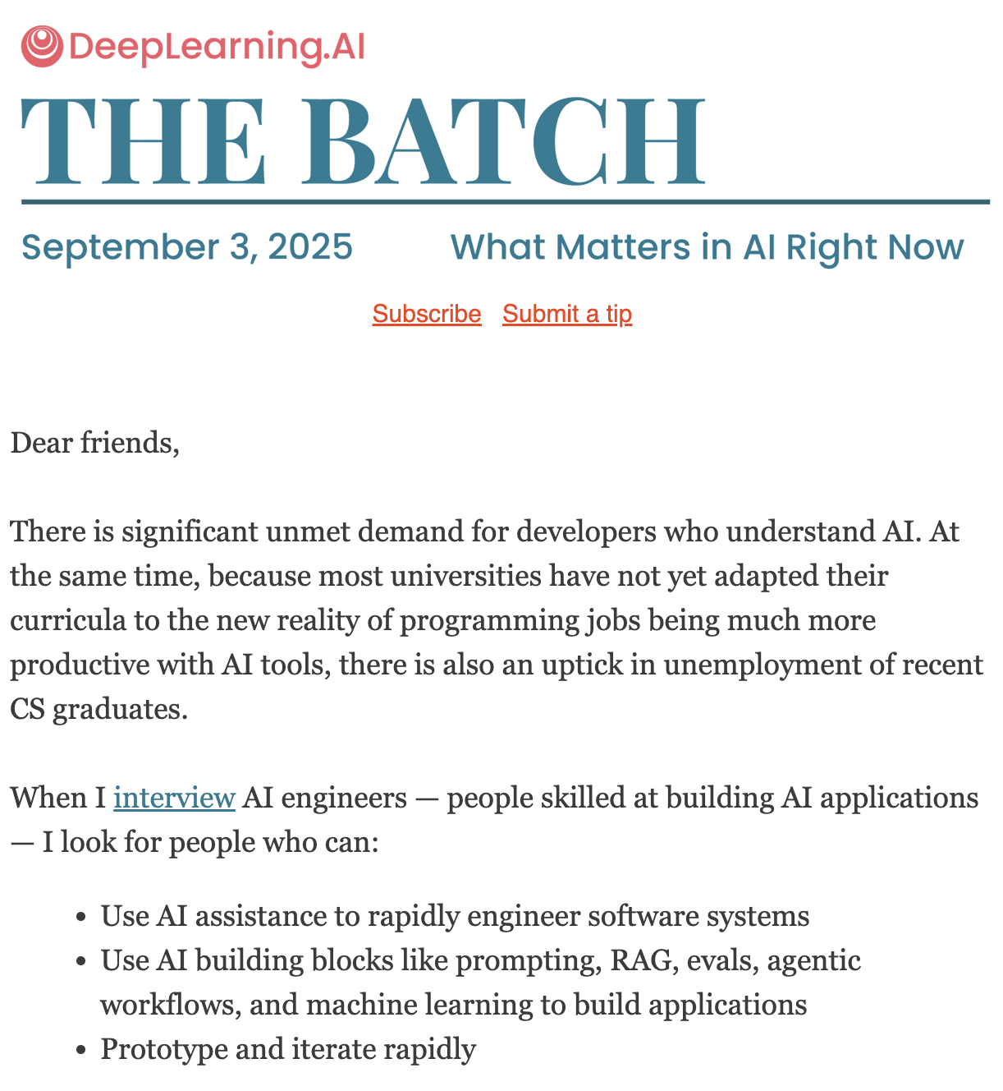
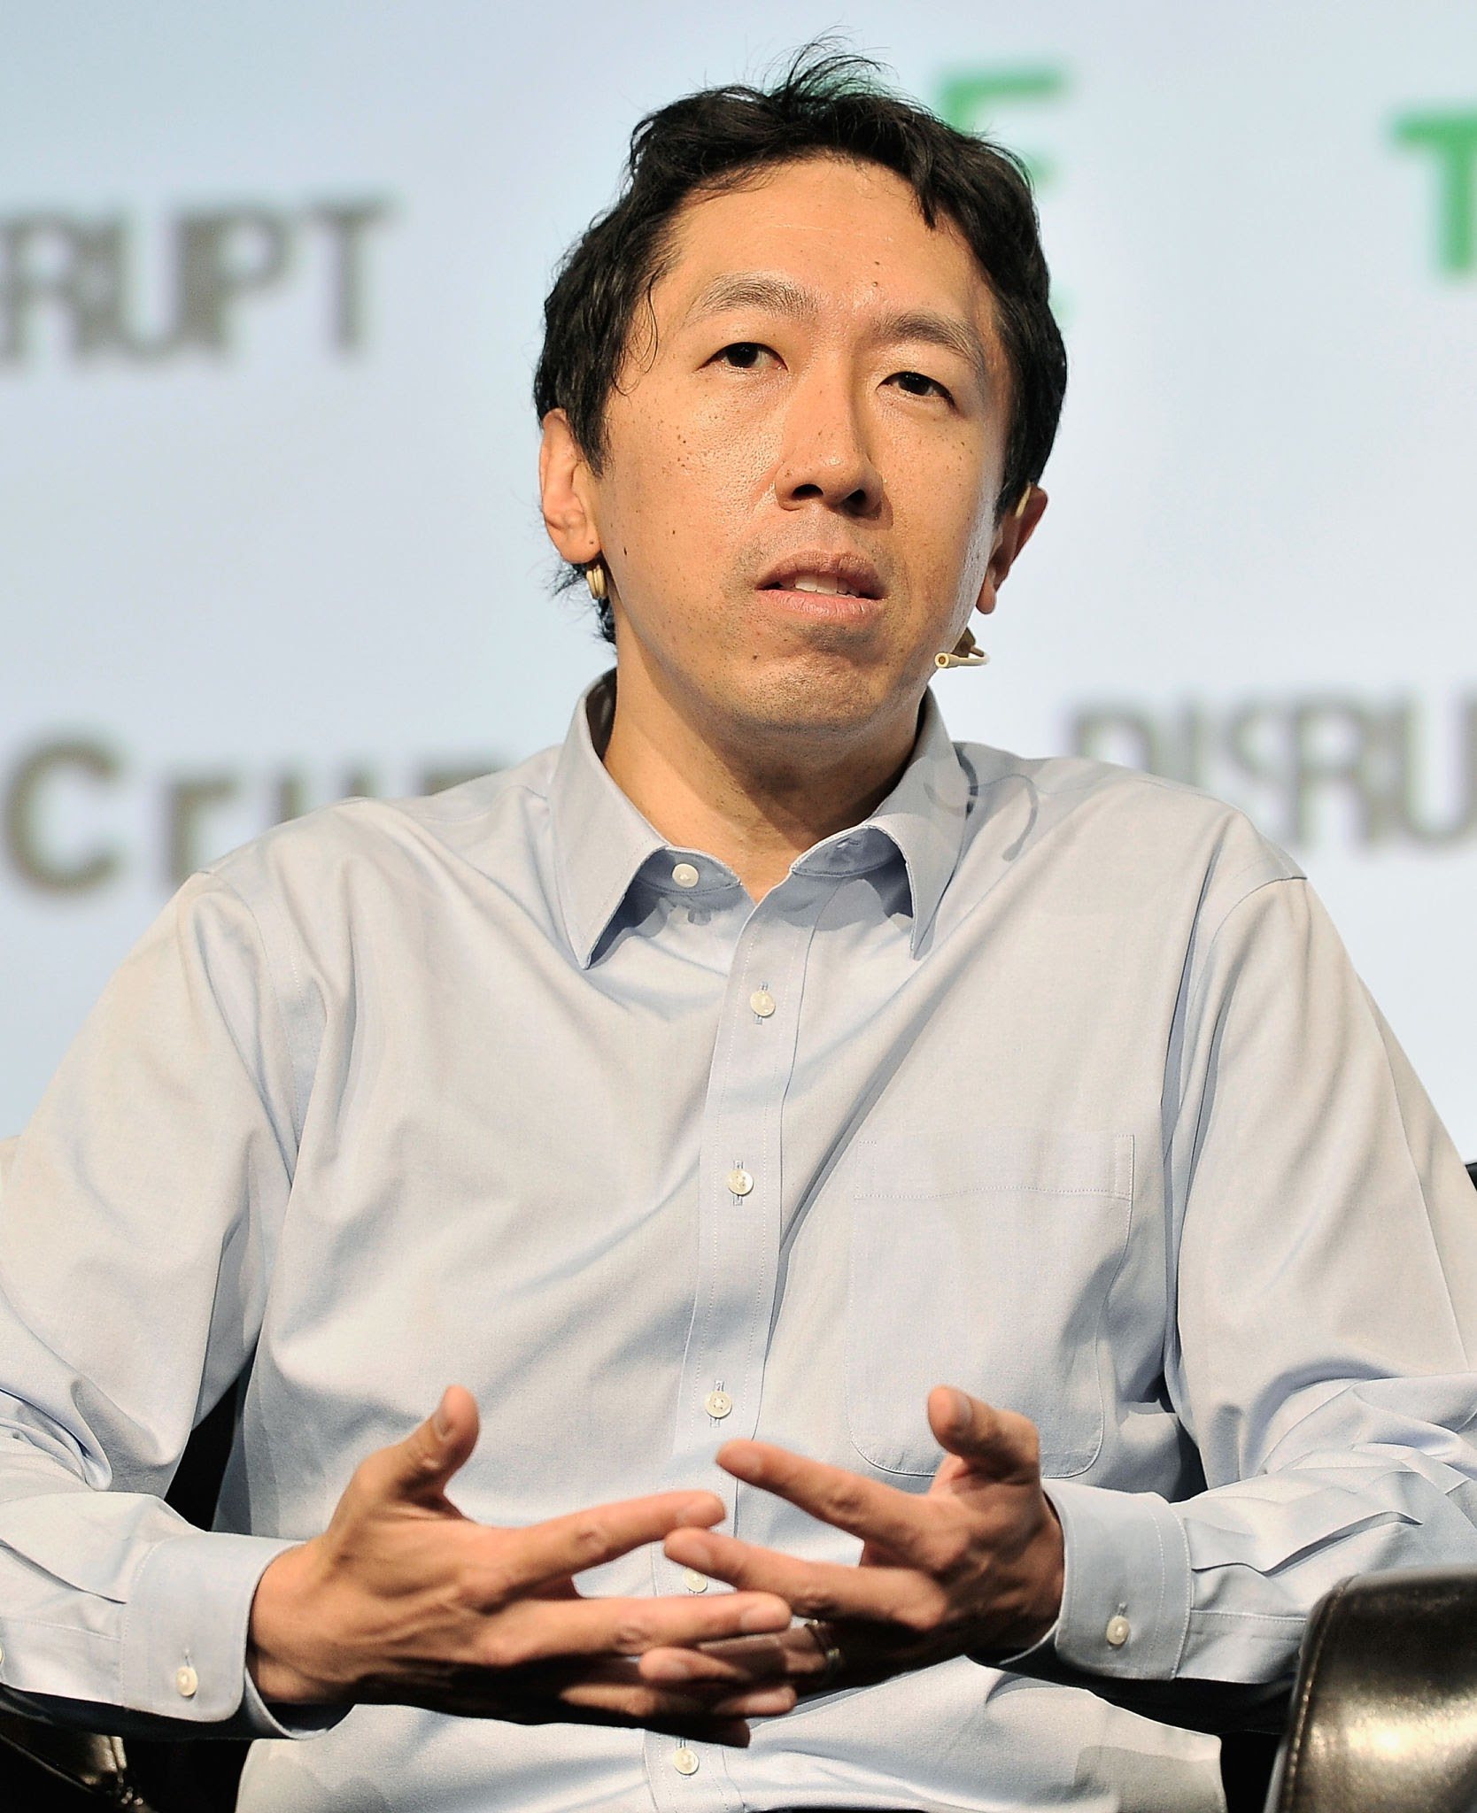
GenAI Usage Policy Should We Use Generative AI?
Andew Ng

Slide 7


GenAI Usage Policy Should We Use Generative AI?
Punchcard Programmer
Andew Ng

Slide 8
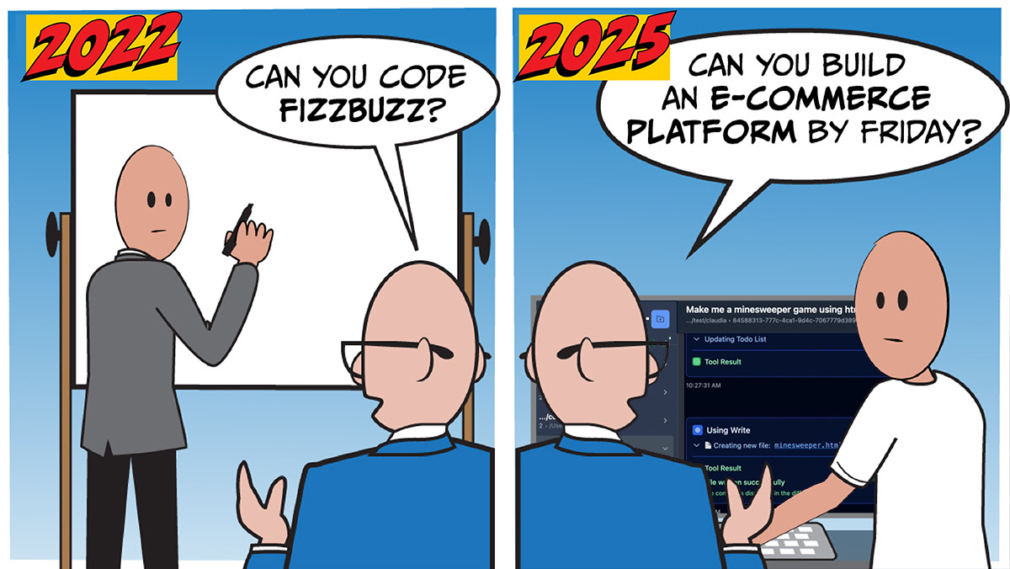
GenAI Usage Policy Should We Use Generative AI?
Andew Ng

Slide 9
GenAI Usage Policy
Coding Agents – OK but carefully verfy results
QA Agents – OK but carefully verfy results
Whatever Agents – OK but carefully verfy results
Feel free to use
However, intensitvely use it as your peers will use it and I’ll use a relative grading system.

Slide 10
Homeworks
HW1
Choose an interesting victim non-generative model
Image classifiers, regressors, object detectors, …
Define an attack goal (~= a security goal)
Implement an attacker to achieve the attack goal.
Present your method in about 20 mins
Persuade me that your selected victim model, attack goal, and method are interesting.
You can also share your failure experience.
You should answer my questions on details.
Probably we may not find novel attack goals or attack methods; that’s fine.

Slide 11
Homeworks
HW2
Choose an interesting victim generative model
LLMs, LRMs, LCMs, diffusion models, VLMs, VLAs
Define an attack goal (~= a security goal)
Implement an existing attacker to achieve the attack goal.
Present your method in about 20 mins
Persuade me that your selected victim model, attack goal, and method are interesting.
You can share your failure experience.
You should answer my questions on details.

Slide 12
Final Project
Use OpenClaw for your victim AI model
Define an attack goal (~= a security goal)
Propose an attacker to achieve the attack goal
Justify why your attacker is novel via table comparison
Again, you can brainstorm with GenAI on novel ideas.
Present your method in about 30 mins
You can share your failure experience but has a little penalty.
You should answer my questions on details.
Your method is consdered to be novel if ChatGPT says so.
(optional) Write a paper in the case of undergrads

Slide 13
Q&A
Welcome any feedback on the HW/Project style

Slide 14
Q&A

Slide 15
Homeworks
HW3
Choose an interesting victim agentic AI model
OpenClaw
Define an attack goal (~= a security goal)
Implement an existing attacker to achieve the attack goal.
Present your method in about 20 mins
You can share your failure experience

